Slide 1
Neural Nets V
Recurrent Neural Nets and GAN’s

Slide 2
Learning Objectives
Use RNNs and LSTMs for longitudinal data / streams
Use GANs where competitive fake data helps
Notes:
In classical neural nets, the data involved are pairs of vectors such as {((1, 2), (3, 4, 5)), ((6, 7), (8, 9, 10)), ((11, 12), (13, 14, 15))}. However, in many situations, data can’t be put into this form. An example is a signal emitted by a star. In that case, the data is infinite—there is no end. In that case, we use recurrent neural nets. These will be explained.
The second type of neural net that we cover in this module is one in which ??????????????

Slide 3
Learning and Intro to Neural Nets
Recurrent Neural Nets
Generative Adversarial Networks
Conclusion

Slide 4
RNN’s
(Adapted or quoted from Le Cun et al)
Process input sequence one element at a time, maintaining in their hidden units a ‘state vector’ with information about the history of all the past elements of the sequence.
Discrete time steps
For tasks that involve sequential inputs, such as speech and language
Can also be used for more complex tasks
Notes:
To learn from streaming data, we proceed in discrete steps of time such as every second. We assume that what occurs in each step is related to past steps. To capture this, we leverage the idea of the state of the process. Formally, a state is a set of values of a variables. For example, if the data stream is a radio station then a variable could be program_type and is values could be news, weather, sports, or game_show. So at some point in the stream, the state may be program_type = weather.

Slide 5
Application Examples
Website active user-per-hour count
Temperature in Boston
Monthly company revenue
Natural language
* Geron “Hands-on …” p503
Notes:
Notice that each of the examples involves a stream of data.

Slide 6
Example Problem: Deconstructing Sentence
habit
goal
← output
y₁
y₂
x₁
x₂
… often sat on a tuffet …
Notes:
A common application of recurrent neural nets (RNNs) is natural language understanding. For example, suppose that the language contained … often sat on a tuffet …
Suppose that our purpose is to identify the habit and the goal that the text is associated with.

Slide 7
RNN Architecture: The Issue
habit
goal
y₁
y₂
w_{y1}
w_{y2}
Sliding window
w_{x1}
w_{x2}
Input sequence
x₁
x₂
sat on a tuffet
sat on a tuffet
sat on a tuffet
Notes:
We can’t deal with entire long sequences of words so we approach them via a sliding window that contains a fixed, manageable number of words as in the figure.

Slide 8
RNN Architecture: Per Recurrent Node (Unrolling)
y(1)
y(2)
y(3)
w_{y1}
w_{y1}
w_{x}
x(1)
x(2)
x(3)
Notes:
RNNs attempt to capture versions of nodes—input, hidden, and output. The figure shows three successive versions of an input node x, three of output y, and three versions of a hidden node (in green). There is one value for the weight of the edge connecting x to the hidden node as usual and one for hidden-to-output—the latter denoted w_{y}. What’s new, however, is the introduction of edges between versions of the hidden node. These are given the weight w_{y}. These connections gives the neural net the opportunity to incorporate history into output because each hidden node is able to account for the previous version (which already accounts for its previous value recursively etc.).

Slide 9
RNN Architecture: Per Recurrent Node
y(1)
y(2)
y(t) = f(w_{x}x(t) + w_{y}y(t-1)
w_{y}
f() = activation function
w_{x}
x(2)
Notes:
The output of each hidden node is computed in the usual way, as illustrated in the figure.

Slide 10
RNN Architecture: Notation
y
x
Notes:
To save space, we usually diagram this process as in the figure.

Slide 11
Training: Backprop on Unrolled (10? Nodes)
y(1)
y(2)
y(3)
w_{y}
w_{y}
w_{x}
x(1)
x(2)
x(3)
Notes:
Training an RNN is a little more complicated. In theory, you unroll the entire neural net, including all versions of every node, and including every input (i.e., at every time interval). This is clearly impractical. So we compromise, and fix the number of node versions at a small number and train on that. The figure shows 3 versions.
So the historical feedback remains but training is on a truncated portion. The result is frequently successful, although training times are longer than for non-recurrent neural nets.

Slide 12
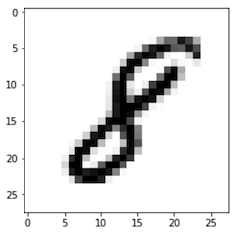
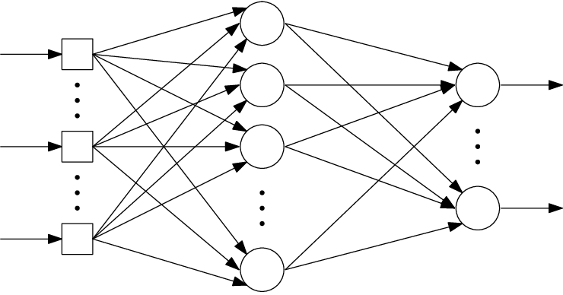
MNIST AS RNN
Input: sequence of rows of MNIST digits,
each row of pixels a “timestep.”*
Predict: the digit's label.
28
64
10
BatchNormalization
applies transformation that maintains mean activation ≈ 0, standard deviation ≈ 1.
* https://www.tensorflow.org/guide/keras/rnn
Notes:
RNNs can be use in many problems with large amounts of data. For example, MNIST—and images in general—require large amounts of input. The reference shown in the figure uses an RNN in which the input accommodates only the width of the image (rather than inputting all of the (x,y) data). The row relationships are captured by the RNN. The RNN remembers previous lines and is thus enabled to recognize the entire number.

Slide 13
MNIST as RNN 1
# https://www.tensorflow.org/guide/keras/rnn import tensorflow as tf batch_size = 64 # Each MNIST image batch is a tensor of shape (batch_size, 28, 28). # Each input sequence will be of size (28, 28) (height is treated like time). input_dim = 28
units = 64 output_size = 10 # labels are from 0 to 9
* https://www.tensorflow.org/guide/keras/rnn
Notes:
The figures show TensofFlow code at https://www.tensorflow.org/guide/keras/rnn for this design.

Slide 14
Recall Tensors and their Shapes
[[1, 2, 3], [4, 5, 6]]
# rank 2 (matrix); shape (2, 3)
(2 elements, each with 3 elements)
[[[1., 2., 3.]], [[7., 8., 9.]]]
# rank 3; shape (2, 1, 3)
Notes:
The shape expresses the size of each dimension, stating with the outer one. For example, the shape [2, 1, 3] says “there are 2 elements in the whole; each of these contains 1 element; the latter contains 3 elements.”

Slide 15
Build RNN Model 2
def build_model(allow_cudnn_kernel=True):
lstm_layer = tf.keras.layers.RNN( tf.keras.layers.LSTMCell(units), input_shape=(None, input_dim))
model = tf.keras.models.Sequential([ lstm_layer, tf.keras.layers.BatchNormalization(), tf.keras.layers.Dense(output_size)] ) return model
NVIDIA CUDA Deep NN lib
“any”
* https://www.tensorflow.org/guide/keras/rnn

Slide 16
MNIST as RNN 3
mnist = tf.keras.datasets.mnist
(x_train, y_train), (x_test, y_test) = mnist.load_data() x_train, x_test = x_train / 255.0, x_test / 255.0 sample, sample_label = x_train[0], y_train[0] model = build_model(allow_cudnn_kernel=True) model.compile(
loss=tf.keras.losses.SparseCategoricalCrossentropy(from_logits=True), optimizer='sgd', metrics=['accuracy']) model.fit(x_train, y_train, validation_data=(x_test, y_test), batch_size=batch_size, epochs=5)
Whether to interpret as a tensor of logit values. By default, we assume probabilities (i.e., in [0, 1]). https://www.tensorflow.org/api_docs/python/tf/keras/losses/BinaryCrossentropy
Use when there are two or more label classes. labels provided as integers. If you want to provide labels using one-hot representation, use CategoricalCrossentropy https://www.tensorflow.org/api_docs/python/tf/keras/losses/SparseCategoricalCrossentropy

Slide 17
Result
60000/60000 [==…=] - 19s 310us/sample - loss: 0.1667 - accuracy: 0.9494 - val_loss: 0.1528 - val_accuracy: 0.9486

Slide 18
Another RNN Example, With Variations
50
Notes:
Here is the architecture of an RNN example with 50 inputs.

Slide 19
Create Example Time Series
def generate_time_series(batch_size, n_steps):
…
Number of sequences
Input sequence size
Notes:
For this illustration, data is artificially generated with this function.

Slide 20
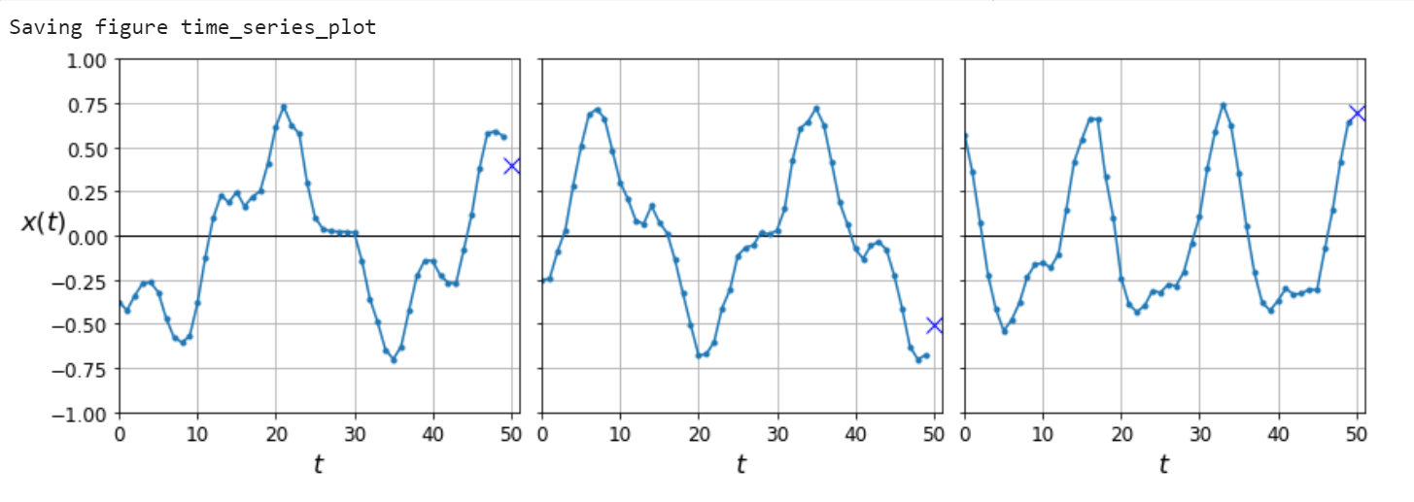
Graphically
Notes:
The data are generated from a function that looks like this. It has the form
sin(a(x + b)) + sin(c(x + d)) + e.

Slide 21
Example Time Series: Add 2 sin(*) values + noise
def generate_time_series(batch_size, n_steps):
freq1, freq2, offsets1, offsets2 = np.random.rand(4, batch_size, 1)
time = np.linspace(0, 1, n_steps)
series = 0.5 * np.sin((time - offsets1) * (freq1 * 10 + 10)) # wave 1
series += 0.2 * np.sin((time - offsets2) * (freq2 * 20 + 20)) # + wave 2
series += 0.1 * (np.random.rand(batch_size, n_steps) - 0.5) # + noise
return series[..., np.newaxis].astype(np.float32)
numpy.random.rand(d0, d1, ..., dn) … Random values in a given shape.
Create array of the given shape, populate with random samples from a uniform distribution over [0, 1).

Slide 22
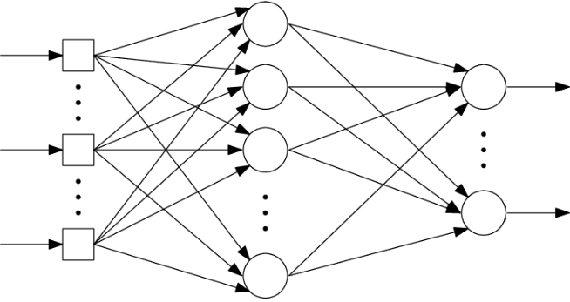
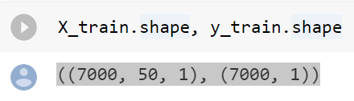
Create Input/Output
50
n_steps = 50
series = generate_time_series(10000, n_steps + 1)
X_train, y_train = series[:7000, :n_steps], series[:7000, -1]
X_valid, y_valid = series[7000:9000, :n_steps], series[7000:9000, -1]
X_test, y_test = series[9000:, :n_steps], series[9000:, -1]

Slide 23
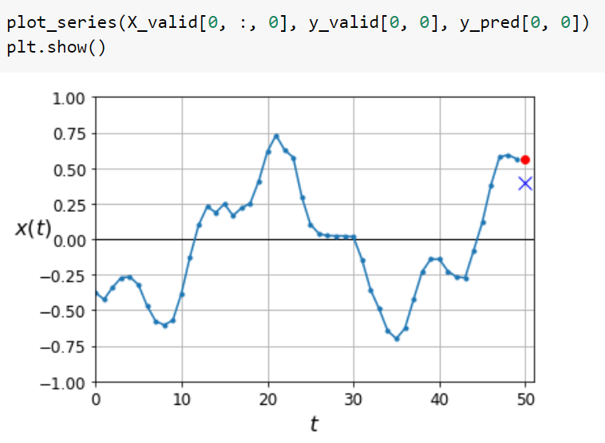
(Very) Naïve Prediction for Comparison --for last observed vallue
compute
Notes:
This figure shows the results of using this LSTM to predict the next data point.

Slide 24
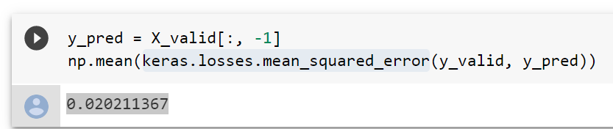
(Very) Naïve Prediction for Comparison --for last observed vallue
Mean of squares of errors between labels and predictions.

Slide 25
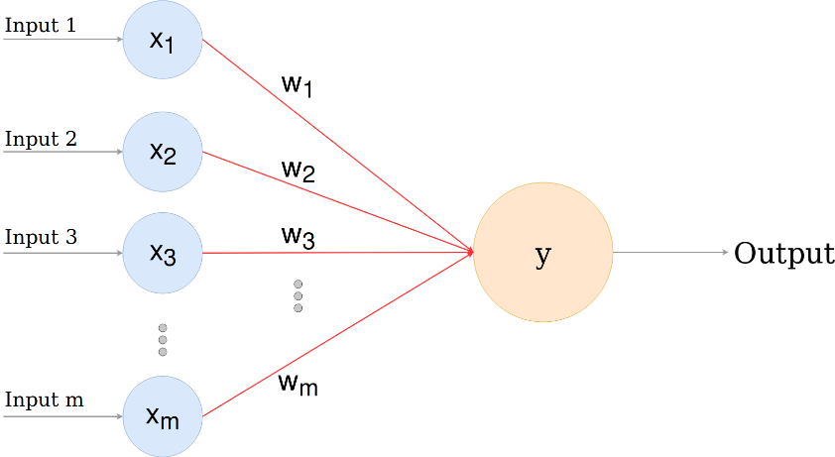
As a Single-level NN
import tensorflow as tf np.random.seed(42) tf.random.set_seed(42) model = keras.models.Sequential([ keras.layers.Flatten(input_shape=[50, 1]), keras.layers.Dense(1) ]) model.compile(loss="mse", optimizer="adam") history = model.fit(X_train, y_train, epochs=20, validation_data=(X_valid, y_valid))
50
Epoch 20/20 7000/7000 [==…=] - 0s 52us/sample - loss: 0.0042 - val_loss: 0.0041
Notes:
This code implements a simple neural net for the data format, using Adam.

Slide 26
(As a Single-level NN): on Last Value
model.evaluate(X_valid, y_valid)
2000/2000 [==…=] - 0s 33us/sample –
loss: 0.0041 0.004145486276596785
Notes:
The loss (error) is 0.0041.

Slide 27
As a Simple RNN
np.random.seed(42) tf.random.set_seed(42) model = keras.models.Sequential([ keras.layers.SimpleRNN(1, input_shape=[None, 1]) ]) optimizer = keras.optimizers.Adam(lr=0.005) model.compile(loss="mse", optimizer=optimizer) history = model.fit(X_train, y_train, epochs=20, validation_data=(X_valid, y_valid))
Notes:
This code implements the same problem as an RNN.

Slide 28
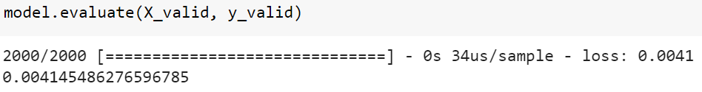
… Not as Good as Plain NN
Epoch 20/20
7000/7000 [==…=] - 3s 374us/sample - loss: 0.0114 - val_loss: 0.0108
Recall:

Slide 29
As a “Deep” RNN
20
np.random.seed(42) tf.random.set_seed(42) model = keras.models.Sequential([ keras.layers.SimpleRNN(20, return_sequences=True,
input_shape=[None, 1]), keras.layers.SimpleRNN(20, return_sequences=True), keras.layers.SimpleRNN(1) ]) model.compile(loss="mse", optimizer="adam") history = model.fit(X_train, y_train, epochs=20, validation_data=(X_valid, y_valid))
20
when stacking RNN layers so that the second RNN layer has a three-dimensional sequence input
https://machinelearningmastery.com/return-sequences-and-return-states-for-lstms-in-keras/
Notes:
Now as an RNN with one layer, which has to RNN weight vectors.

Slide 30
Deep RNN Results
Epoch 20/20
7000/7000 [==…=] - 7s 1ms/sample - loss: 0.0032 - val_loss: 0.0029
model.evaluate(X_valid, y_valid)
2000/2000 [==…=] - 0s 239us/sample - loss: 0.0029
0.0029341068509966136
Notes:
The loss for this architecture stabilizes around 0.0029.

Slide 31
LSTM’s: Reclaiming RNN Lost Information
Problem
Finiteness of RNNs lose information
Solution
Long-Short Memory NN’s (LSTMs) retain what’s needed long-term
Notes:
Long-Short Memory (LSTM’s) retain information that would otherwise be lost in a RNN.

Slide 32
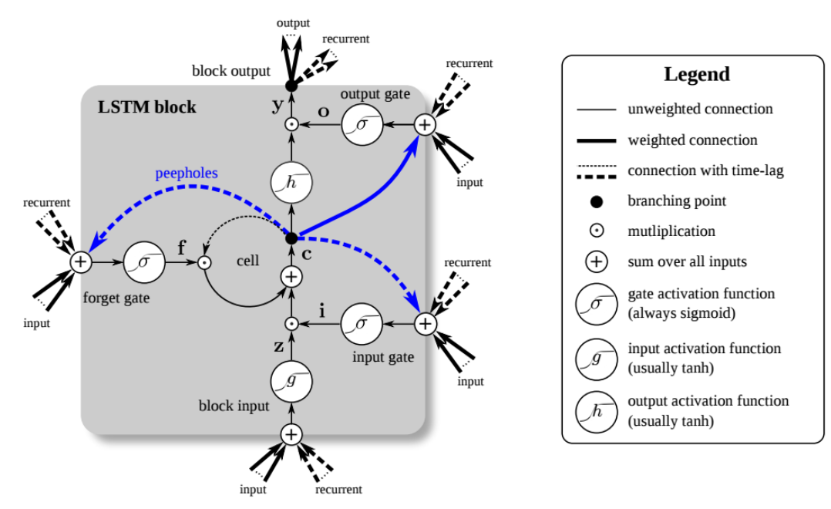
LSTM Architecture
Which part of long-term to transmit
Which part should be added to long-term
Usual RNN node
https://developer.nvidia.com/discover/lstm
Notes:
The figure, from https://developer.nvidia.com/discover/lstm, explains LSTM architectures. First is the plain RNN (at the bottom). Second, at right, are long-term recurrent input that the designer wants added to input and to output. Third, at left, is data that the designer wants dropped.

Slide 33
LSTM Architecture
https://developer.nvidia.com/discover/lstm
Notes:
This figure shows what happens to the data described. “block input” refers to “input in a block.” Notice the time lag on “forget” data. You don’t want this forgotten until after the lag. “Peepholes” are essentially places of input—both new an recurrent.

Slide 34
Example Geron “Hands-on Machine Learning …(O’Reilly): quoted and adapted below
https://colab.research.google.com/github/ageron/handson-ml2/blob/master/15_processing_sequences_using_rnns_and_cnns.ipynb
https://github.com/ageron/handson-ml2/blob/master/15_processing_sequences_using_rnns_and_cnns.ipynb

Slide 35
Learning and Intro to Neural Nets
Recurrent Neural Nets
Generative Adversarial Networks
Conclusion

Slide 36
GANs*
Can generate new data from existing
Example: https://thispersondoesnotexist.com/
Increasingly used for
super-resolution
colorization
Sketch → photo-realization
identifying weaknesses in models
…
* Geron: "Hands-On Machine Learning with Scikit-Learn, Keras, and TensorFlow: Concepts, Tools, and Techniques to Build Intelligent Systems 2nd Edition"
Notes:
Generative associate networks are an interesting way to generate data that’s used with or instead of real data.

Slide 37
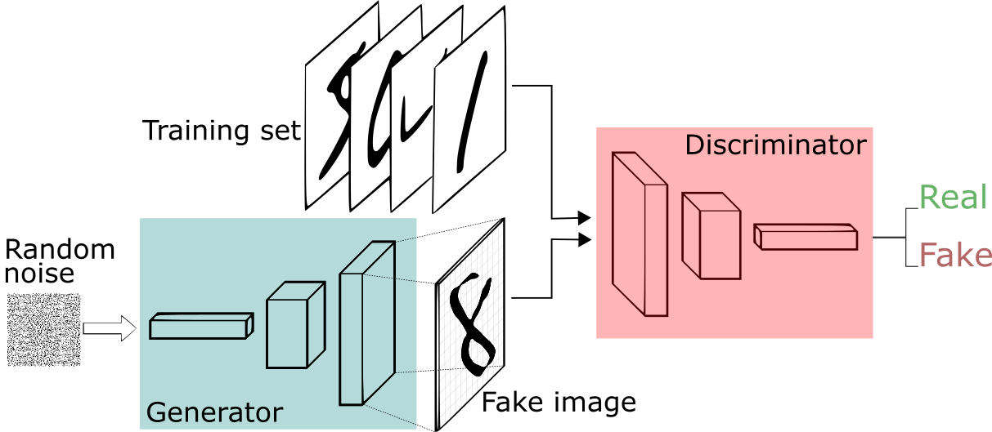
GAN: Overall Architecture
(1)
(3)
or
(2)
https://www.google.com/url?sa=i&url=https%3A%2F%2Fpathmind.com%2Fwiki%2Fgenerative-adversarial-network-gan&psig=AOvVaw0loPeUwKF-ahKyszxTNuqr&ust=1583264477730000&source=images&cd=vfe&ved=0CAIQjRxqFwoTCJiH28rG_OcCFQAAAAAdAAAAABAD
Notes:
GANs consist of (1) training sets, (2) a generator that outputs tensors in the same format, and (3) a discriminator between two inputs.

Slide 38
Training Phase 1: Train Discriminator (NN)
or
Fixed in random state
Notes:
The discriminator is first trained to distinguish between real elements (in the training set) and fake ones (generated by the generator).

Slide 39
Training Phase 2: Train Discriminator (NN)
Fixed
Notes:
Now the discriminator is kept constant and the generator is trained to generate images recognized as “real”. We can now generate data of a desired form from random noise.

Slide 40
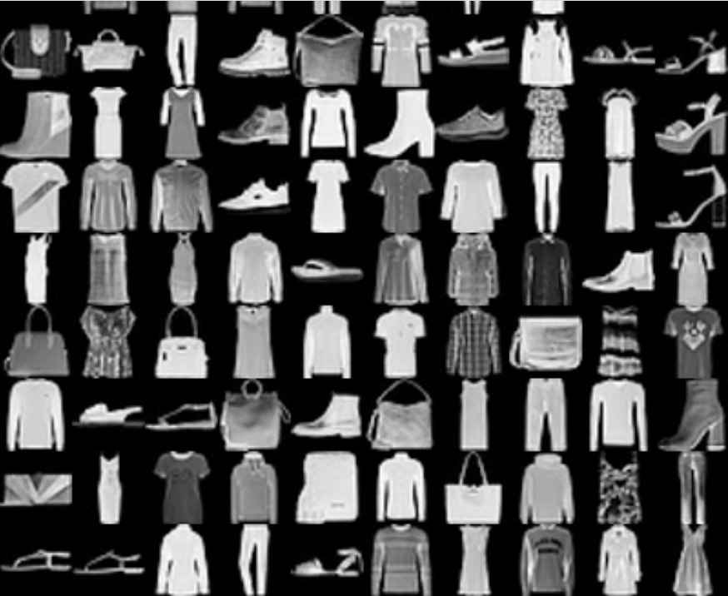
Fashion MNIST Data
Notes:
The figure shows some Fashion MNIST data. The output is one of ten of clothing categories such as “socks.”

Slide 41
Example GAN for Fashion MNIST
“First, … import … ensure MatplotLib plots ... check . Python 3.5 … installed … Scikit-Learn ≥0.20 … TF ≥2.0.”
(X_train_full, y_train_full), (X_test, y_test) \ = keras.datasets.fashion_mnist.load_data() X_train_full = X_train_full.astype(np.float32) / 255 X_test = X_test.astype(np.float32) / 255 X_train, X_valid = X_train_full[:-5000], X_train_full[-5000:] y_train, y_valid = y_train_full[:-5000], y_train_full[-5000:]
https://colab.research.google.com/github/ageron/handson-ml2/blob/master/17_autoencoders_and_gans.ipynb
Notes:
The code shown is from https://colab.research.google.com/github/ageron/handson-ml2/blob/master/17_autoencoders_and_gans.ipynb, for Fashion MNIST.

Slide 42
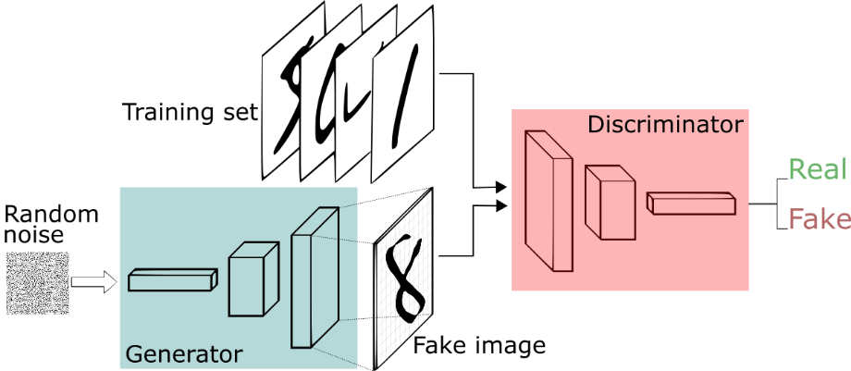
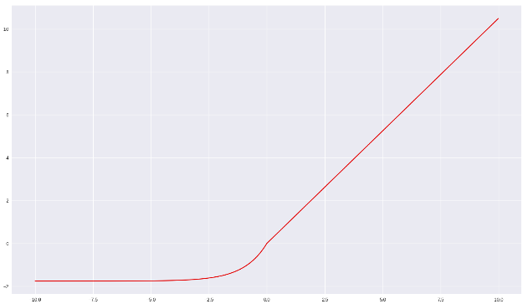
GAN for FMNIST: Define Generator
np.random.seed(42) tf.random.set_seed(42) codings_size = 30 generator = keras.models.Sequential([ keras.layers.Dense(100, activation="selu", input_shape=[codings_size]), keras.layers.Dense(150, activation="selu"), keras.layers.Dense(28 * 28, activation="sigmoid"), keras.layers.Reshape([28, 28]) ])…
scaled exponential linear
Notes:
The generator is a simple neural net. (It will take random input.)

Slide 43
Define Discriminator
np.random.seed(42) tf.random.set_seed(42) codings_size = 30 generator = keras.models.Sequential([ keras.layers.Dense(100, activation="selu", input_shape=[codings_size]), keras.layers.Dense(150, activation="selu"), keras.layers.Dense(28 * 28, activation="sigmoid"), keras.layers.Reshape([28, 28]) ]) discriminator = keras.models.Sequential([ keras.layers.Flatten(input_shape=[28, 28]), keras.layers.Dense(150, activation="selu"), keras.layers.Dense(100, activation="selu"), keras.layers.Dense(1, activation="sigmoid") ]) gan = keras.models.Sequential([generator, discriminator])
Notes:
The discriminator is also simple.

Slide 44
Compile; Prepare Data
discriminator.compile(loss="binary_crossentropy", optimizer="rmsprop") discriminator.trainable = False gan.compile(loss="binary_crossentropy", optimizer="rmsprop") batch_size = 32 dataset = tf.data.Dataset.from_tensor_slices(X_train).shuffle(1000) dataset = dataset.batch(batch_size, drop_remainder=True).prefetch(1)
Notes:
Compilation and dataset definition are not unusual.

Slide 45
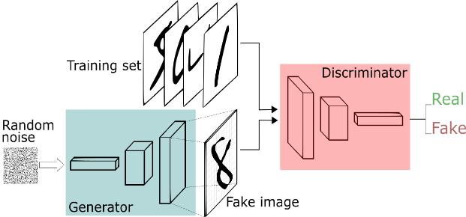
Define Discriminator Training
or
def train_gan(gan, dataset, batch_size, codings_size, n_epochs=50): generator, discriminator = gan.layers for epoch in range(n_epochs): print("Epoch {}/{}".format(epoch + 1, n_epochs)) for X_batch in dataset: # phase 1 - training the discriminator noise = tf.random.normal(shape=[batch_size, codings_size]) generated_images = generator(noise) X_fake_and_real = tf.concat([generated_images, X_batch], axis=0) y1 = tf.constant([[0.]] * batch_size + [[1.]] * batch_size) discriminator.trainable = True discriminator.train_on_batch(X_fake_and_real, y1) # phase 2 - …
Notes:
Here is where the code carries out the GAN process described above:
RANDOM DATA, NORMALLY DISTRIBUTED:
noise = tf.random.normal(shape=[batch_size, codings_size])
RUN GENERATOR ON THIS DATA: generated_images = generator(noise)
DEFINE A MIX OF THESE (FAKE) WITH MNIST INPUT (REAL) X_fake_and_real = tf.concat([generated_images, X_batch], axis=0)
TRAIN THE DISCRIMINATOR ON THIS MIX y1 = tf.constant([[0.]] * batch_size + [[1.]] * batch_size) discriminator.trainable = True discriminator.train_on_batch(X_fake_and_real, y1)

Slide 46
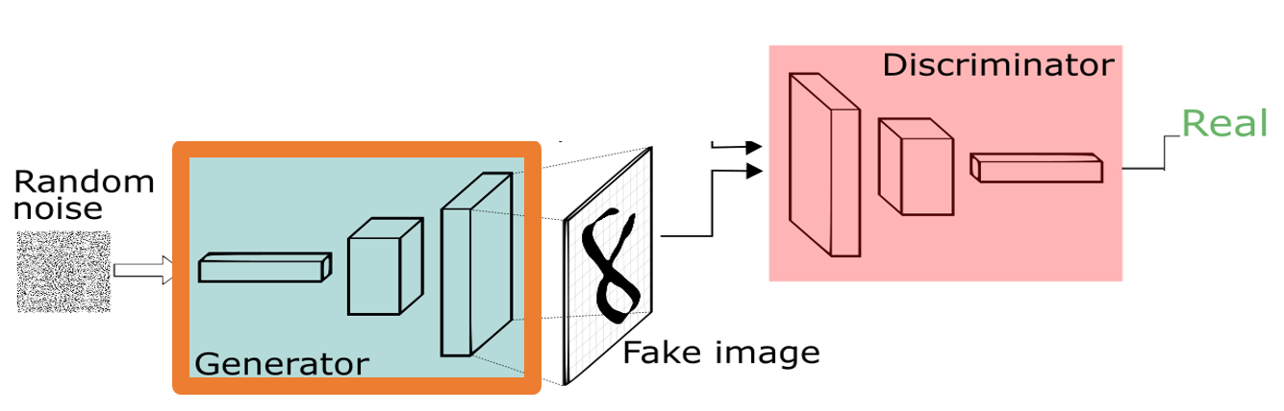
Define Generator Training
def train_gan(gan, dataset, batch_size, codings_size, n_epochs=50): generator, discriminator = gan.layers for epoch in range(n_epochs): print("Epoch {}/{}".format(epoch + 1, n_epochs)) for X_batch in dataset: … # phase 2 - training the generator noise = tf.random.normal(shape=[batch_size, codings_size]) y2 = tf.constant([[1.]] * batch_size) discriminator.trainable = False gan.train_on_batch(noise, y2) plot_multiple_images(generated_images, 8) plt.show()
Notes:
CREATE MORE RANDOM DATA
noise = tf.random.normal(shape=[batch_size, codings_size]) y2 = tf.constant([[1.]] * batch_size)
FREEZE DISCRIMINATOR discriminator.trainable = False
TRAIN THE GENERATOR TO GENERATE OUTPUT THAT TESTS REAL gan.train_on_batch(noise, y2)

Slide 47
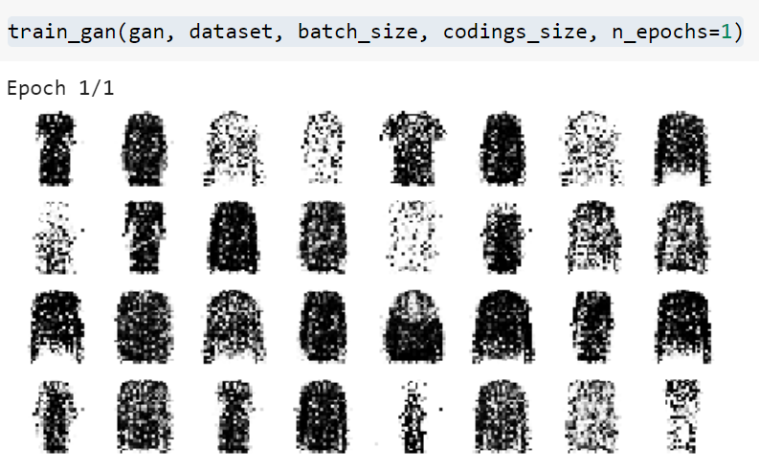
Train: After 1 Epoch
train_gan(gan, dataset, batch_size, codings_size, n_epochs=1)
Notes:
The figure shows recognizable images (created from random!) even after one epoch.

Slide 48
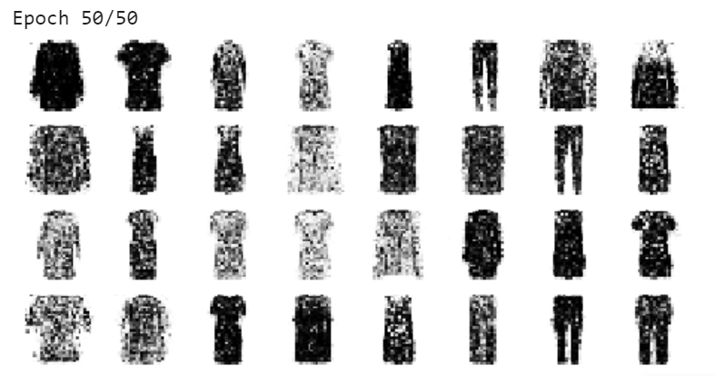
Train All 50 Epochs
train_gan(gan, dataset, batch_size, codings_size)

Slide 49
Learning and Intro to Neural Nets
Recurrent Neural Nets
Generative Adversarial Networks
Conclusion

Slide 50
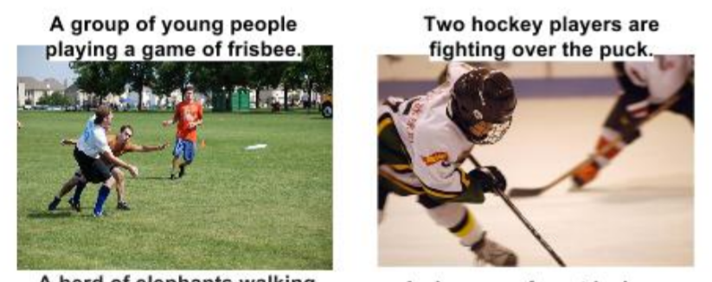
Combining CNNs and RNNs
Generating image captions
https://arxiv.org/pdf/1411.4555.pdf
Notes:
In this application, the input is an image and the output is a caption.

Slide 51
Combining CNNs and RNNs
https://arxiv.org/pdf/1411.4555.pdf

Slide 52
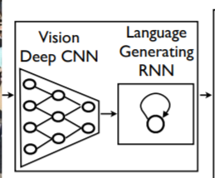
Combining CNNs and RNNs
https://arxiv.org/pdf/1411.4555.pdf
Notes:
The figure roughly shows the architecture.

Slide 53
Summary
RNNs for longitudinal data / stream
GANs when generated data helps
Watch for transformers
Multi-headed attention

